Slide 1
APK Modding
K.A.Sudharsan
Santhanam S.J
Notes:
APK Modding

Slide 2
Disclaimer
APK Modding is strictly not a legal practice . But you can still do it for your own personal use.
Notes:
Disclaimer

Slide 3

What is an APK?
APK = Android Package Kit
(or) Android Application Package
Notes:
What is an APK?
APK is the package file format used by the Android operating system for distribution and installation of mobile apps. Just like Windows (PC) systems use an .exe file for installing software, the APK does the same for Android.

Slide 4
What is APK Modding?
APK Modding is essentially modifying the contents of an application package.
Notes:
What is APK Modding?
It is possible to modify the resources like images, colors, strings, values, etc. and sometimes even the Java code behind it.

Slide 5
Why APK Modding?
Notes:
Why APK Modding?
By modding the APKs, it is possible to unlock features of the app which were previously impossible/paid. Some examples are: Dark themed apps, free premium access to some apps, unlimited money/gems in games, etc.

Slide 6

Why APK Modding?
Notes:
Subway surfer example

Slide 7
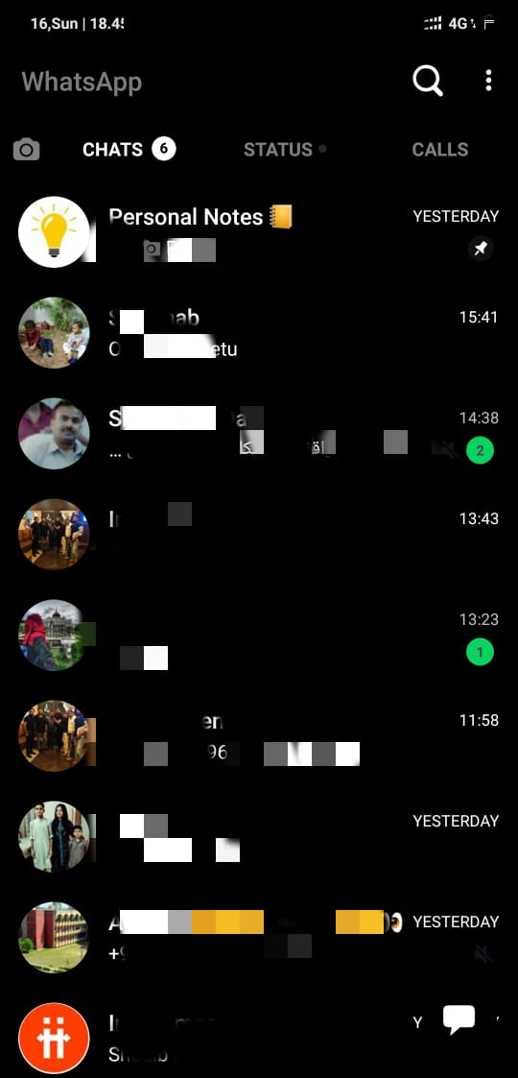
Why APK Modding?
Notes:
Whatsapp dark themed mode example

Slide 8

Notes:
Meme

Slide 9
Before we jump into APK Modding, let’s have a quick overview of how an app is made
Notes:
Before we jump into APK Modding, let’s have a quick overview of how an app is made

Slide 10
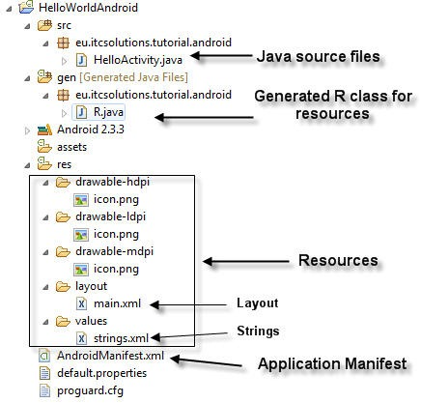
Components of an Application
Notes:
Components of an Application

Slide 11
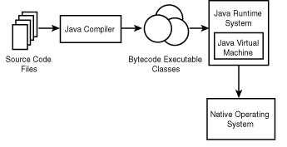
Java Compilation
Notes:
Java Compilation
The java bytecode files i.e .class files are independent of the operating system.

Slide 12
The Build Process
A. Java Compilation
Android java code files compiles to .class files via javac command
.class files gets converted to .dex :
.class files is also known as Java byte-code. This byte code further gets converted to dalvik byte-codes which is the format Android OS understands. All .class files and any .jar library files compiles to single classes.dex using dx command. DEX is called as Dalvik executable files.
DEX files is memory efficient and loads very swiftly compared to JVM based .class files and is lightweight too .

Slide 13
The Build Process
B. Packaging ( .APK file) :
Packaging is done using the Android Asset Packaging Tool (AAPT). It generates a .apk file from a DEX file + non-Java libraries + zipped resources. This .apk file is what you run on android device and is distributed to all the major app stores after being signed for release. User gets to download this files from Google Play Store and other app stores on their android powered device.

Slide 14
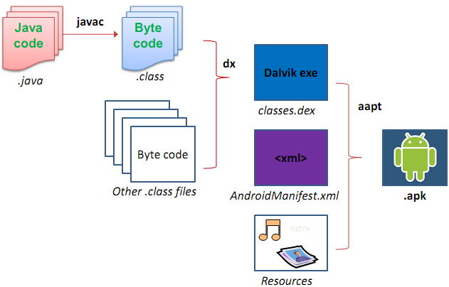
The Build Process
Notes:
Build Process
Because most mobile devices are severely constrained in the amount of memory, processing power, and battery life available, ART offers superior performance to the JVM. One key feature that helps achieve this is that ART performs both Ahead-of-Time and Just-in-Time compilation.

Slide 15
How to mod an APK?
Notes:
How to mod an APK?

Slide 16
Steps involved
There are basically 4 steps involved in modding an APK:
Decompiling
Recompiling
Signing
Zip-aligning
Notes:
Steps involved
Decompiling
Recompiling
Signing
Zip-aligning

Slide 17
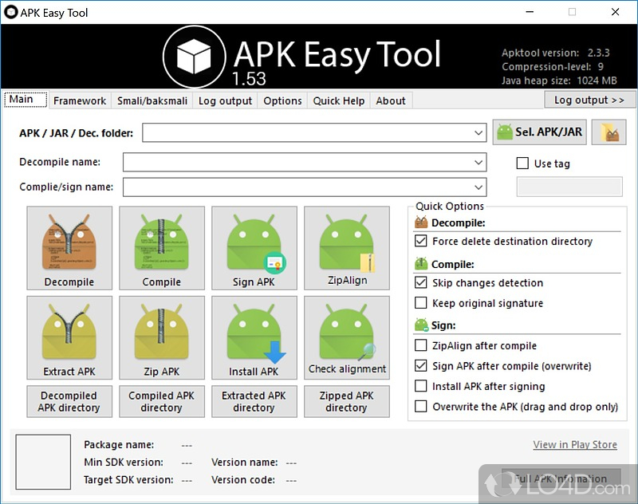
APK Easy Tool is a package for Windows that has everything in a single place
Notes:
Windows package APK Easy Tool

Slide 18
Decompiling
APK is just another file format for a zip file. It is an archive of the following:
resources
classes.dex
AndroidManifest.xml
By decompiling, we just extract those files from an APK.
Notes:
Decompiling
APK is just another file format for a zip file. It is an archive of the following:
resources
classes.dex
AndroidManifest.xml
By decompiling, we just extract those files from an APK.
Decompile the apk

Slide 19
Decompiling
In Linux, the tool used for this is apktool and the command is:
apktool d apk_file_name.apk
By decompiling the APK, we get the Manifest files and the resources as it was during compilation.
The java files which were compiled into classes.dex are now available in an intermediate format called .smali files.

Slide 20
Time to make some changes...
Notes:
Time to make some changes

Slide 21
Recompiling
After making all the modifications, we need to recompile the contents to generate the modified a.k.a modded APK.
Notes:
Recompiling
After making all the modifications, we need to recompile the contents to generate the modified a.k.a modded APK.

Slide 22
It’s time to test the changes.
Notes:
It’s time to test the changes

Slide 23

Not so
fast….
Notes:
Not so fast meme

Slide 24
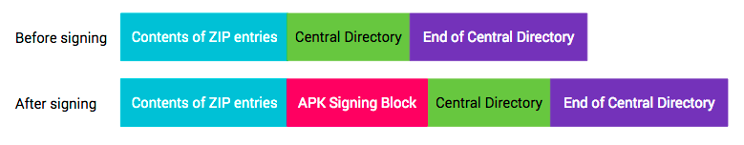
Signing
Notes:
Signing
The basics behind protecting your Android app is to use a generated certificate and digital “key” which provides a unique, encrypted, and reasonably un-hackable signature.
While creating updates for the same app in the Play Store, it is required that the apk is signed using the same key.
This proves that the app came from you and not some other suspicious source.

Slide 25
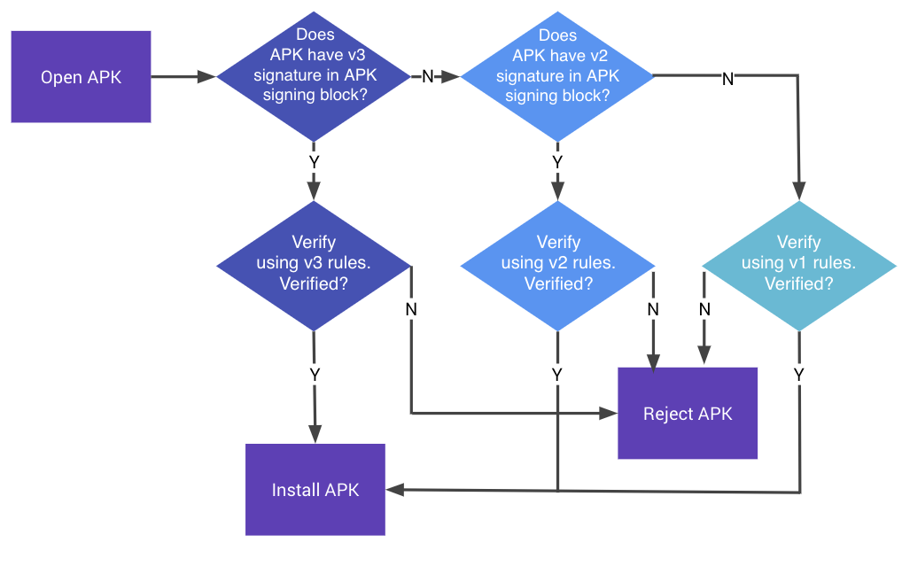
Signing
Notes:
Signing
The basics behind protecting your Android app is to use a generated certificate and digital “key” which provides a unique, encrypted, and reasonably un-hackable signature.
While creating updates for the same app in the Play Store, it is required that the apk is signed using the same key.
This proves that the app came from you and not some other suspicious source.

Slide 26
Signing
To sign an apk, first we need to generate the certificate and key. There are lot of tools available to do the same. You can also download a pre-generated certificate and key since you are using it only for modding purposes.
A tool called SignApk is available which provides you the certificates and the key to enable signing.
The command for signing is:
java -jar signapk.jar certificate.pem key.pk8 apk_file_name.apk apk_file_name_signed.apk

Slide 27
Zip Aligning (Optional)
Zip Aligning optimizes the way an APK is packaged. Doing so enables the Android operating system to interact with the application more efficiently, and hence has the potential to make the application and overall the whole system much faster. Execution time is minimized for zipaligned applications, resulting in lesser amount of RAM consumption when running the APK.

Slide 28
Zip Aligning (Optional) - How does it work?
In an Android operating environment, data files stored in each application package are accessed by multiple processes, for example, the Home application, will read resources to get the application’s name and icon.
Since Android is based on a multi-tasking operating infrastructure, these files are continually and repeatedly accessed.

Slide 29
Zip Aligning (Optional) - How does it work?
Android is Linux-based and hence memory-mapping plays a key role in efficient handling of processes. Essentially, the optimal alignment for the Android OS code is 4-byte boundaries.
What this means is that, if APKs are memory-mapped to 4-byte boundaries, and aligned accordingly, the OS will not need to ‘read through’ the memory to get to the required data.
Every system process will know in advance where to look for it’s desired resources, and hence will execute much smoother and faster.

Slide 30
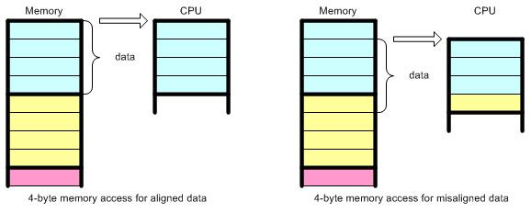
Zip Aligning (Optional)
Notes:
Zip Aligning
Android is Linux-based and hence memory-mapping plays a key role in efficient handling of processes. Essentially, the optimal alignment for the Android OS code is 4-byte boundaries.
What this means is that, if APKs are memory-mapped to 4-byte boundaries, and aligned accordingly, the OS will not need to ‘read through’ the memory to get to the required data.
Every system process will know in advance where to look for it’s desired resources, and hence will execute much smoother and faster.

Slide 31
Zip Aligning (Optional)
Android Studio provides a built in zip aligner which can be found inside your Android SDK folder that can be used to align the apks.
The command for zip aligning is:
./zipalign -v 4 apk_filename_signed.apk apk_filename_signed_aligned.apk
This outputs an aligned APK.

Slide 32
Now, let’s test our changes...
Notes:
Now let’s test our changes

Slide 33
How about modifying the Java code?
Notes:
How about modifying the java code?

Slide 34
.dex to .jar
The dex2jar package converts a .dex file to a .jar file.
A JAR file is nothing but a Java Archive file. It is something similar to a zip file but for Java classes. It takes many .class files and compresses them into a single .jar file.
It is mainly used to package a library consisting of many java files as a single file.
Notes:
.dex to .jar
The dex2jar package converts a .dex file to a .jar file.
A JAR file is nothing but a Java Archive file. It is something similar to a zip file but for Java classes. It takes many .class files and compresses them into a single .jar file.
It is mainly used to package a library consisting of many java files as a single file.

Slide 35
.jar to .class
.jar to .class is pretty simple to get since they are just an archive of those files. There are many tools available online as well as packages.
A simple command to extract it is:
jar xf jarfilename
Notes:
.jar to .class
.jar to .class is pretty simple to get since they are just an archive of those files. There are many tools available online as well as packages.
A simple command to extract it is:
jar xf jarfilename

Slide 36
If it is so easy to get the .class files of any apk, it should be very easy to mod them.
Notes:
If it is so easy to get the .class files of any apk, it should be very easy to mod them.

Slide 37
Is it though………?
Notes:
Is it though?

Slide 38
Proguard
Proguard is a free Java class file shrinker, optimizer and obfuscator.
Shrinking - detects and removes unused classes, fields, methods, and attributes.
Optimizing - optimizes bytecode and removes unused instructions.
Obfuscating - renames the remaining classes, fields, and methods using short meaningless names.

Slide 39
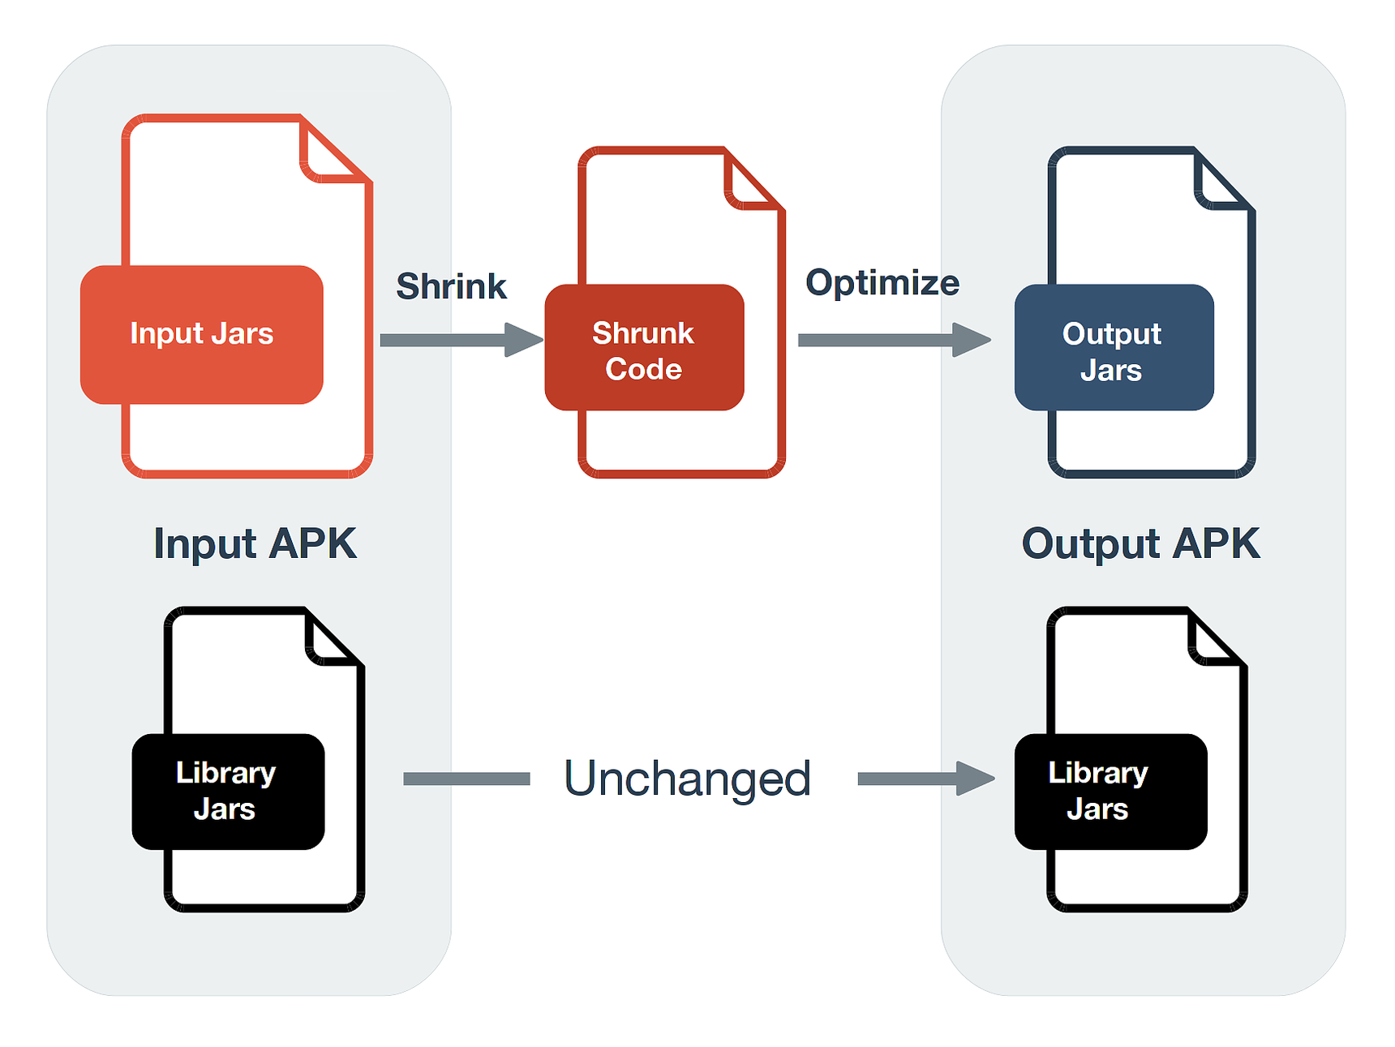
Proguard
Notes:
Proguard
Proguard is a free Java class file shrinker, optimizer and obfuscator.
Shrinking - detects and removes unused classes, fields, methods, and attributes.
Optimizing - optimizes bytecode and removes unused instructions.
Obfuscating - renames the remaining classes, fields, and methods using short meaningless names.
It is mainly used for two purposes in android applications:
Since it is easy to reverse engineer android applications, it is used to rename the class names and variables to meaningless values.
It reduces the apk file size.

Slide 40
Summing it up...
An APK is nothing but an archive of the resources, classes.dex and the AndroidManifest file of an application.
The java class files are converted into dalvik executables (.dex files) for faster processing by the Android OS.
It is very easy to modify the resources of an application compared to the java source code.

Slide 41
Summing it up...
Modding an APK consists of mainly 4 steps:
Decompiling
Recompiling
Signing
Zip Aligning

Slide 42
Summing it up...
Modifying the java source code is difficult due to two reasons:
It is not possible to directly obtain the .java files of an application. Rather, we get only the .class files.
Most applications use a proguard to rename the class names and variables to small meaningless values to make the reverse engineering difficult.

Slide 43
Thank you!

